Slide 1
Inverted Pyramid News Style

Slide 2
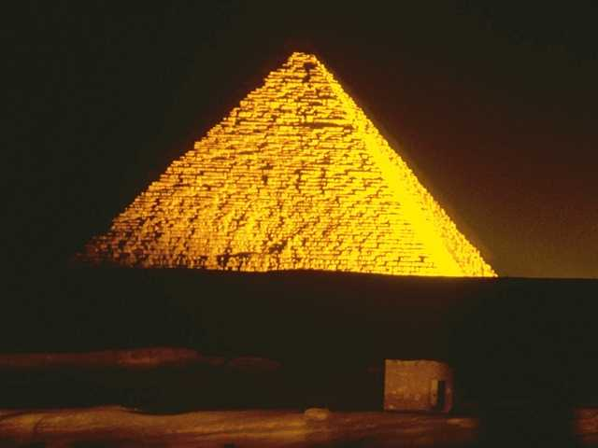
News Style = Inverted Pyramid
Pyramid begins with the lead
Lead contains most significant information in one sentence

Slide 3
First sentences of The Chant’s news stories must have
Who
What
How
Why
Where (may not be necessary for reviews)
When (comes last, rarely needed for reviews)
In order of importance

Slide 4
The shocking news for you first time news writers…
You absolutely must tell the result of the event first!
This means giving …
game scores,
election winners,
change in policy etc.
IMMEDIATELY!

Slide 5
Why must the “end” (result) come first?
Readers are in a hurry and will only read what strikes them as
important,
interesting, or
worthy of their time.

Slide 6
…And
Readers are lazy
They want information quickly
They often don’t read news through to the end
If they don’t make it to the end, what information must they absolutely have about this topic?

Slide 7
…However
Readers can be enticed to read further
If you have a snappy, catchy lead, readers are more likely to read further (even if not all the way)
If you offer them reasons to read further, they will
Make them feel like authorities via your article
Surprise them
Present a conflict and tension so that they want to know more

Slide 8
…Remember
Readers are self-centered
Think like a reader
How will it affect me?
What does this have to do with me?
What is in this for me?

Slide 9
…Oh yeah
If an editor needs to cut an article due to space limitations, he/she starts at the end.
This is less important information so it will not be terribly missed
It is not necessary for understanding of the story

Slide 10
Lead Example 1
After a series of neighboring governmental revolts, the Great Socialist People’s Libyan Arab Jamahiriya (commonly know as Libya) became the latest subject of civil unrest after anti-government supporters demanded that the chief of state, Colonel Muammar Abu Minyar al-Qadhafi, resign in February.
— from “Cairo Revolution spurs Middle East domino effect” by Brittini Ray in The Chant, April 2011

Slide 11
Analysis of the lead
Who —
the Great Socialist People’s Libyan Arab Jamahiriya (commonly know as Libya) and anti-government supporters
became the latest subject of civil unrest
Libya
demanded that the chief of state, Colonel Muammar Abu Minyar al-Qadhafi, resign
After a series of neighboring governmental revolts,
in February
What —
Where —
Why —
How —
When —

Slide 12
Continue writing the story giving information in descending order of importance
Do NOT write in chronological order
Unless you have a really powerful reason for doing so!

Slide 13
Yes! This is difficult.
Of course you witnessed the event in the order it happened, but readers don’t care about the order!
Just like everything else… write in order of importance.
If a reader does not reach the end of the article, what do you most want him/her to know?

Slide 14
If you need to write the event in the order it happened, go ahead —as your first draft.
Then number each paragraph by order of importance.
Yes, this means you may need to tell the finale first
Your transitions will become vital to show when each activity occurred

Slide 15
Inversion Example
Inverted Pyramid Example
Lead begins article…
This summer, while students vacationed, educators Mrs. Lawson, AP Language teacher; Mrs. Delhey, AP coordinator; and Mrs. Davis, Pre-AP English teacher, continued to work, presenting at the AP® Conference in Washington DC from July 15 to July 18.
— from “College Board invites three NC educators to D.C.” by Caity Szalay in The Chant, September 2010

Slide 16
Inversion Example cont.
Second paragraph pulls in audience with quotation from source involved in program mentioned in lead
“I cannot think of three better teachers to represent NC at a conference. Mrs. Davis and Mrs. Lawson are both amazing teachers, and Mrs. Delhey is the best magnet coordinator ever. I feel confident that they set a great example for our school,” junior Carlos Alaras said.

Slide 17
Inversion Example cont.
Third paragraph continues the order of importance. It expands of the “how” of the story
Mrs. Lawson completed a proposal during October 2009, hoping to represent NC and present a session during the 2010 Conference. In January of 2010 the College Board chose their submission..

Slide 18
Inversion Example cont.
Fourth paragraph offers insight from a participant and provides a second voice
“I was very excited to be chosen to present; it was nice to know that my work was of value to others,” Mrs. Davis said.

Slide 19
Inversion Example cont.
Fifth paragraph expands on details
Their session, Jump-Starting Student AP Success: AP Boost Camp, taught other educators how to prepare their students for AP work and showed how AP Boost Camp could help transition kids from on-level and honors classes to challenging AP classes.

Slide 20
Inversion Example cont.
Sixth paragraph gives a different perspective from something indirectly involved
“I think that the AP Boost Camp is very helpful and should be done at every school that has AP classes. It really helped me learn about the differences between honors and AP classes and how to make sure that I succeeded in my AP classes,” senior Mark Lockwood said.

Slide 21
Inversion Example cont.
Seventh paragraph gives more details, info not necessary to understand the whole story, but still important to the event
The College Board told them to prepare for 80 people, but their session attracted at least 12 people. Each person at the session received an information packet, and the first 80 received a disc containing 30 documents that other schools could use to create their own camp. Mrs. Davis came up with idea to give out the disc; her previous conference experiences caused her to know how helpful a CD would be.

Slide 22
Inversion Example cont.
Eighth paragraph adds details…
The presentation lasted for an hour and fifteen minutes, and its audience asked more questions than the presenters could answer in the allotted time.

Slide 23
Inversion Example cont.
Ninth paragraph provides a fourth voice, someone who participated in the event
“Thank you so much for a great presentation and your willingness to share your resources,” Janet Blanford, conference attendee, wrote to the presenters in an email.

Slide 24
Inversion Example cont.
Tenth paragraph rounds out the details
Educators from all over the country and the world from places far away like China and closer areas such as Virginia attended the Conference to create a better AP world.

Slide 25
Inversion Example cont.
Final paragraph ends with insight from the third presenter
“My favorite part about the conference was meeting other educators and learning about their practices that could enhance our school,” Mrs. Delhey said.

Slide 26
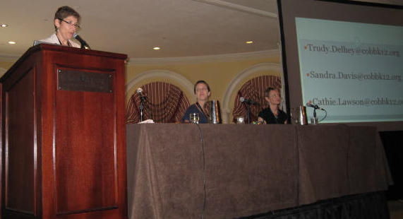
Inversion Example cont.
That also means it needed two photos, at least!
This was a front page story, so it is longer than most stories. It must jump from page one to another, inside page

Slide 27
You can do it!
Before attempting any news story, read past examples from The Chant
Remember that the first draft is for you
Self-edit
Practice
Think like a harried, self-centered, bored reader!

Slide 28
More Exciting News Writing Details to Come …
The Hit List

